Slide 1
Considerations in designing trustworthy virtual labs
Lauren Thornton
Lancaster University
l.thornton2@lancaster.ac.uk

Slide 2
BACKGROUND
Trust matters
Well-placed trust
Many different trusts

Slide 3
DESIGNING TRUSTWORTHY VIRTUAL LABS
What characteristics and features can be designed into virtual labs to provide evidence of trustworthiness and to allow users to place or withhold trust appropriately?
Transparency?
Provenance?
Social aspects?

Slide 4
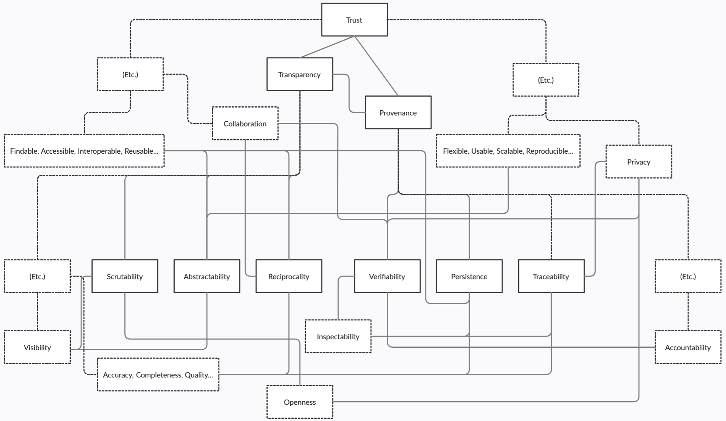
DESIGNING TRUSTWORTHY VIRTUAL LABS
(Thornton, Knowles & Blair, 2021 https://doi.org/10.1145/3442188.3445871)

Slide 5
COLLABORATION AND CO-PRODUCTION
“From our perspective, the digital world appears to be populated by technologies that impose walls between people, rather than by technologies that create windows between them” (Erickson & Kellogg, 2000:80 https://doi.org/10.1145/344949.345004)

Slide 6
REFLECTIONS
Does this resonate?
Do we afford trust with this approach or is there something missing?
How do we balance competing interests?
Can (or should) we generalise?
Are there any aspects of existing technology that apply here?
Is a nuanced approach worthwhile?

Slide 7
Thank you
Link to the survey:
https://lancasteruni.eu.qualtrics.com/jfe/form/SV_ehw41HxwAq8bdfn

